Slide 1
A Study of Changes in Populations
Lesson 4

Slide 2
Unit Central Question
What is the process that leads to changes in populations of organisms over time?

Slide 3
Lesson 4 Focus Question
Which of the four factors of natural selection is necessary to explain the changes we see in populations in nature over time?

Slide 4
Making Links: Stickleback and Snails!
 | Stickleback | Snails
Habitat
Variation in traits
Predator(s)
Reproductive Habits
Food Source(s)

Slide 5
Making Links: Models and the Natural World
Analogy Map
Part of the Model |  | Part of the Natural World
The raisins | Represent(s)…
The M&Ms
The forceps/tweezers
The tall cup or pail
Raisins or M&Ms placed in the discard container
Rolling the die

Slide 6
Snail Simulation: Part 1
Generation | Number of Thin-Shelled Snails | Number of Thick-Shelled Snails | Total number of snails in population | Percentage of Thin-Shelled Snails | Percentage of Thick-Shelled Snails
1 | 15 | 5 | 20 | 75% | 25%
2
3
4
5

Slide 7
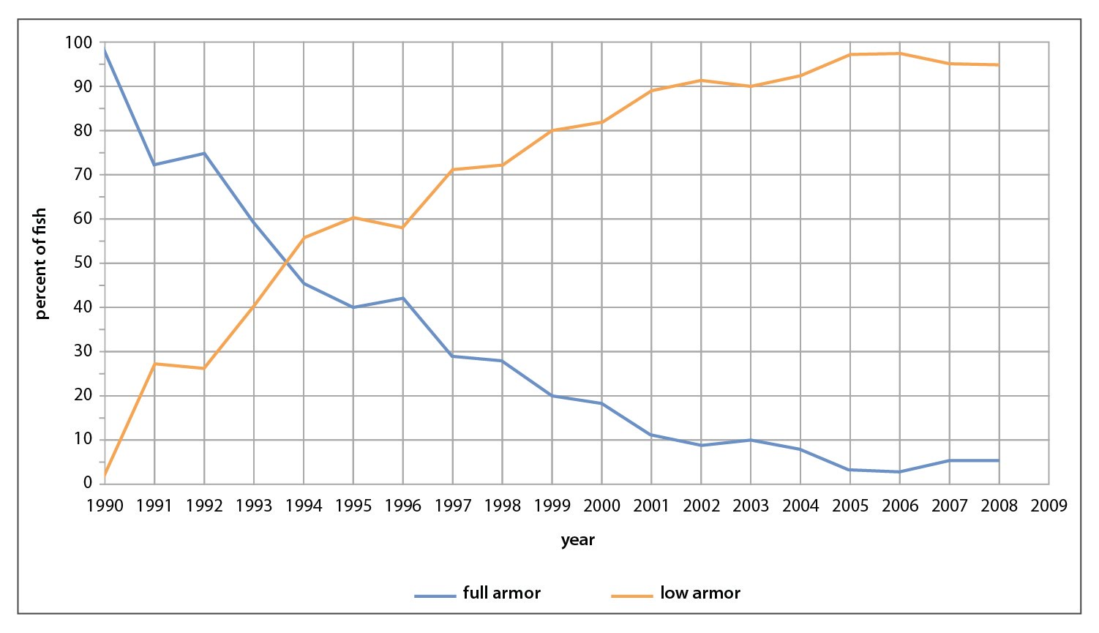
Stickleback in Loberg Lake
Percent of Fish in Population Sample with Full and Low Body Armor

Slide 8
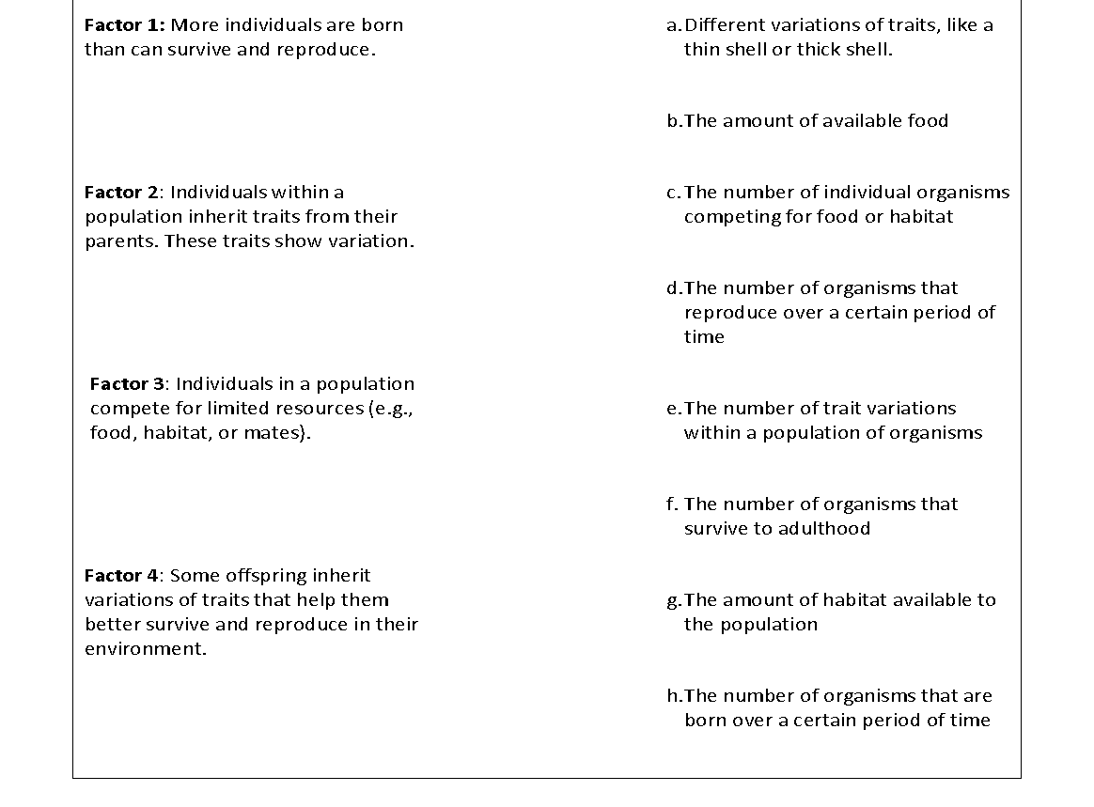
Snail Simulation: Part 2

Slide 9
Snail Simulation: Part 2
Cause | Change to the Simulation
Factor 1: More individuals are born than can survive and reproduce. To eliminate Factor 1 from the population, we need to…
Factor 2: Individuals within a population inherit traits from their parents. These traits show variation. To eliminate Factor 2 from the population, we need to…
Factor 3: Individuals in a population compete for limited resources (e.g., food, habitat, or mates). To eliminate Factor 3 from the population, we need to…
Factor 4: Some offspring inherit variations of traits that help them better survive and reproduce in their environment. To eliminate Factor 4 from the population, we need to…

Slide 10
Snail Simulation: Part 2
If Factor 1 is NOT present in the population…..then….
If Factor 2 is NOT present in the population…..then….
If Factor 3 is NOT present in the population…..then….
If Factor 4 is NOT present in the population…..then….

Slide 11
Four Factors of Natural Selection
Factor 1: More individuals are born than can survive and reproduce.
Factor 2: Individuals within a population inherit traits from their parents. These traits show variation.
Factor 3: Individuals in a population compete for limited resources (e.g., food, habitat, or mates).
Factor 4: Some offspring inherit variations of traits that help them better survive and reproduce in their environment.

Slide 12
Four Factors of Natural Selection
Factor 1: More individuals are born than can survive and reproduce. | Factor 2: Individuals within a population inherit traits from their parents. These traits show variation.
Factor 3: Individuals in a population compete for limited resources (e.g., food, habitat, or mates). | Factor 4: Some offspring inherit variations of traits that help them better survive and reproduce in their environment.

Slide 13
Lesson 4 Focus Question
Which of the four factors of natural selection is necessary to explain the changes we see in populations in nature over time?

