Slide 1
A Study of Changes in Populations
Lesson 5

Slide 2
Unit Central Question
What is the process that leads to changes in populations of organisms over time?

Slide 3
Lesson 5 Focus Question
What causes a population of organisms to change over time? How can an explanation of what happened to the population help people predict what might happen in the future?

Slide 4

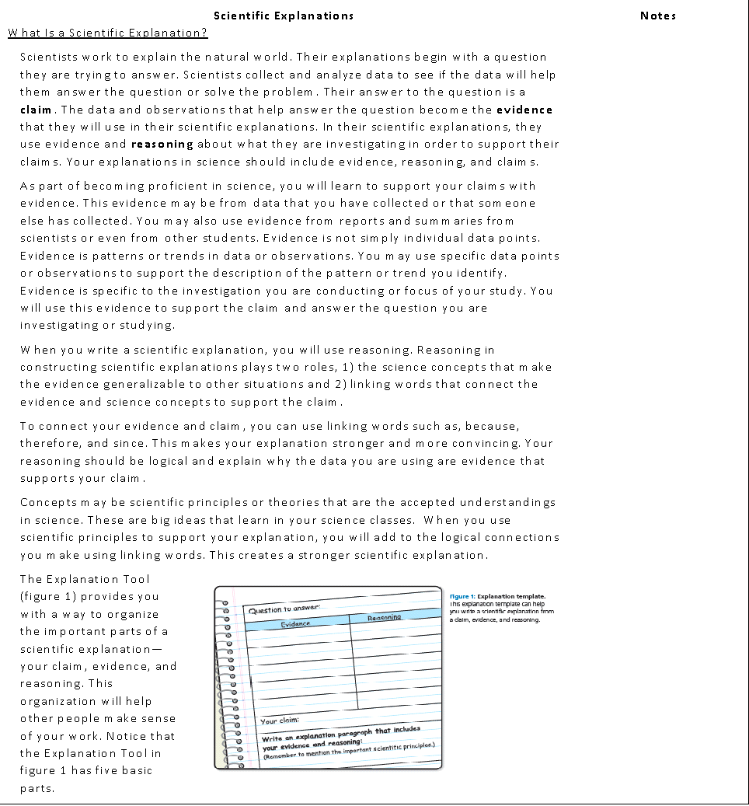
Scientific Explanation

Slide 5
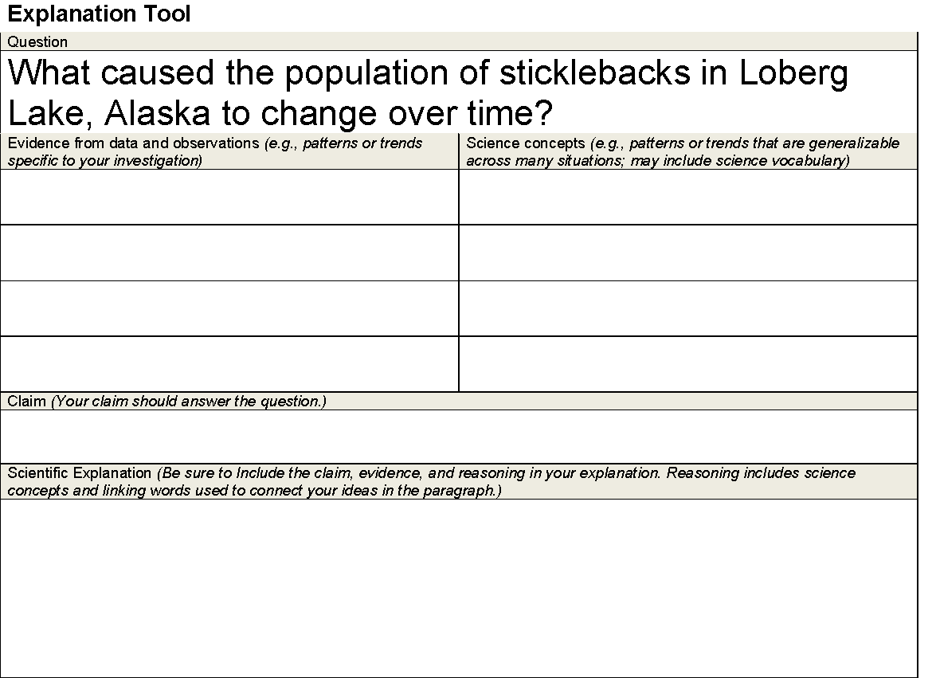
Scientific Explanations
Use the sentence strips as either evidence statements or science concepts. Match evidence gathered through the lessons that link to the concepts.

Slide 6
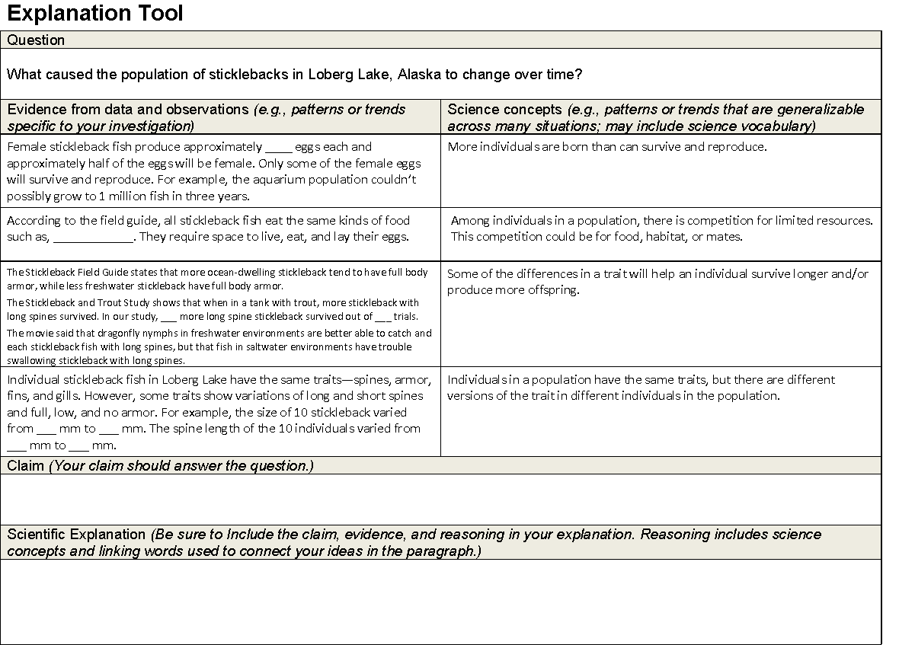
Scientific Explanations
Use the sentence strips as either evidence statements or science concepts. Match evidence gathered through the lessons that link to the concepts.
Write a scientific explanation that answers the question. Be prepared to share your explanation.

Slide 7
CCCR
Consider-Contribute-Consult-Revise
Consider and think individually. Write down your best ideas.
Contribute your ideas with a partner.
Consult your partner.
Revise your ideas.
  Make revisions in a different colored pen or pencil

Slide 8
Lesson 5 Focus Question
What causes a population of organisms to change over time? How can an explanation of what happened to the population help people predict what might happen in the future?

