Slide 1
A Study of Changes in Populations
Lesson 6

Slide 2
Unit Central Question
What is the process that leads to changes in populations of organisms over time?

Slide 3
Lesson 6 Focus Question
What causes a population of organisms to change over time?

Slide 4
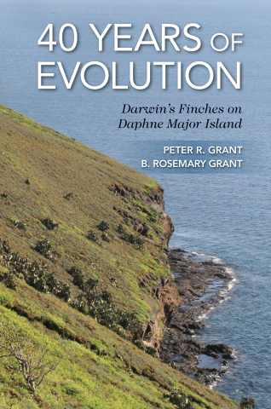
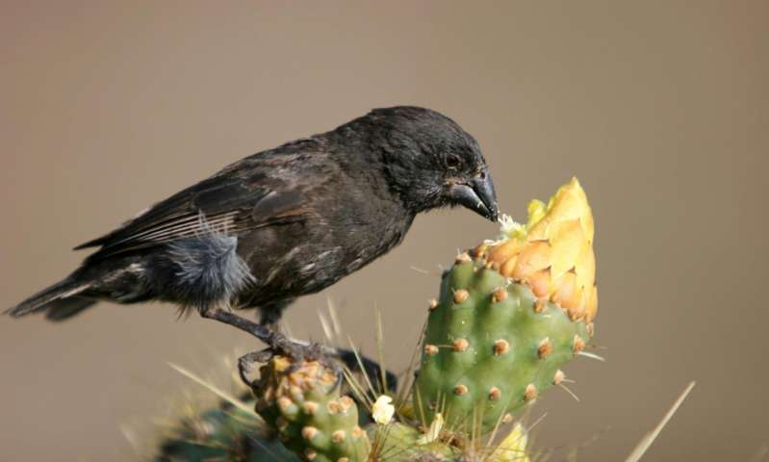
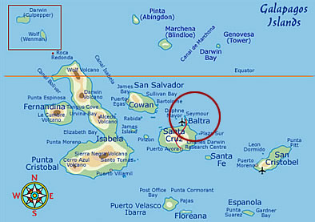
Finches in the Galapagos
https://phys.org/news/2016-04-evolution-action-darwin-finches.html
https://animalcorner.co.uk/daphne-major-island/

Slide 5
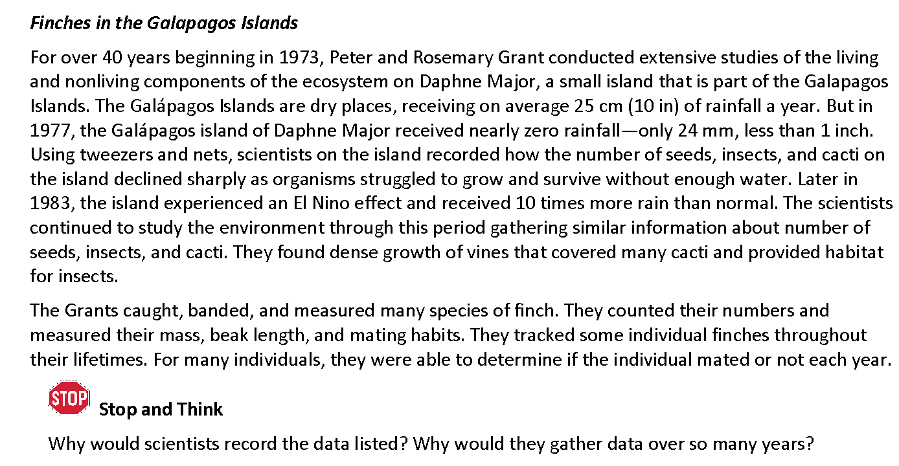
Finches in the Galapagos
Read the text and discuss the Stop and Think questions with your team.

Slide 6
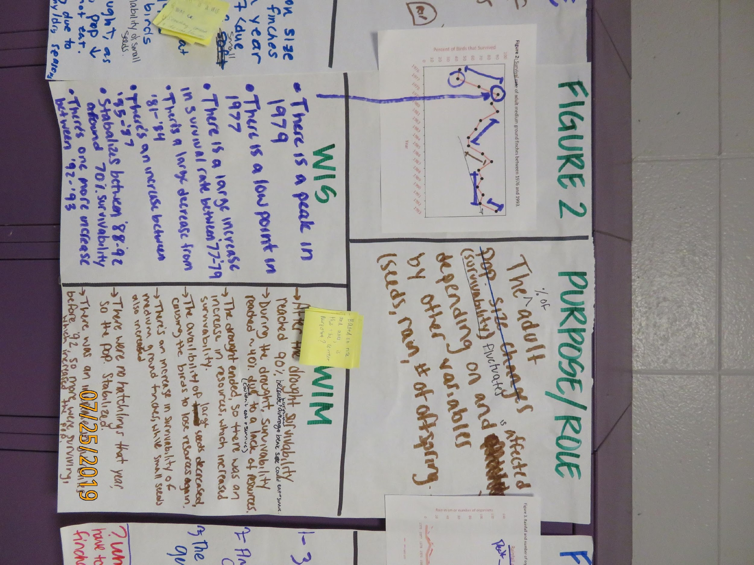
STEP3: Analyzing and Interpreting Data
Step 3 Option 2: Figures 1-10
WIS
Gallery Walk
WIM/Purpose
Gallery Walk and Feedback
Complete Table 1: Figures and summary

Slide 7
STEPS 4-6
Evaluate the evidence
Evidence that supports Claim A
Evidence that support Claim B
Develop a scientific argument for the best explanation (claim, evidence, and reasoning) along with a rebuttal.

Slide 8
STEP 7: Refine your ideas
Exchange your part of the Argument with another member of your team.
Read your partner’s part of the Argument as your partner reads your part.
Ask questions to clarify your understanding of what your partner wrote. Your partner will now then questions about what you wrote.
Provide feedback to your partner on sticky notes. Write at least two questions or pieces of feedback related to your partner’s part of the Argument. What you write should help your partner improve their part of the argument. Place each sticky note on your partner’s Argument Tool near the information that generated your question or feedback.
Return the Argument Tool and sticky notes to your partner.
Read through the sticky notes related to your work. Decide if you agree with what is written. If you agree, revise your work in a different color. If you do not agree, write a statement on the back of the sticky note to explain why you are not taking the advice.

Slide 9
Cause and Effect
How did thinking about cause and effect help you explain the changes in populations over time (or not)?

Slide 10
Lesson 6 Focus Question
What causes a population of organisms to change over time?

