Slide 1
A Study of Traits
Lesson 1

Slide 2
Unit Central Question
SE L1-1
What is the best explanation for the similarities and differences we see in individuals within a species – not only one species, but for every species of plant and animal?
Notes:
Introduce Central Question: Why do individuals of the same species all look different? What causes the variations we see in individuals?
Introduce the central question for the unit and ask participants to respond to the question in their workbooks, leaving space so that they can modify their response as needed.
Ask participants to share their ideas with the entire group. Use STeLLA Strategy 1: Ask questions to elicit student ideas and predictions to get a variety of ideas out. Probe ideas when needed.

Slide 3
Focus Question #1
SE L1-2
What might cause individuals to have versions of a trait that are different from others in the same species?
Notes:
BSCS focus: Elicit and Probe
Introduce Lesson Focus Question:
Let participants know that in today’s lesson they will focus on why individuals can have different versions of the same trait, such as fur color.
Introduce the focus question, “What might cause individuals to have versions of a trait that are different from others in the same species?”
Ask participants to respond to the question in their workbooks, remind them to leave space so that they can modify their response as they learn more information.
Have participants share their ideas with the entire group. Use STeLLA Strategy 1: Ask questions to elicit student ideas and predictions to get a variety of ideas out. Probe ideas as needed.
Setup for the Activity: Case Studies Jigsaw
Assign participants to home groups of 3 people. Have them number off in their groups, 1-3.

Slide 4
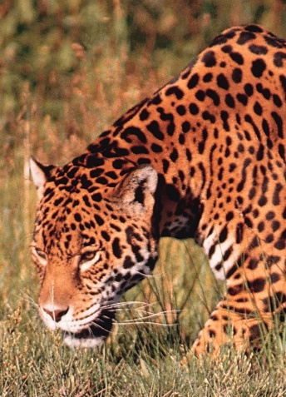
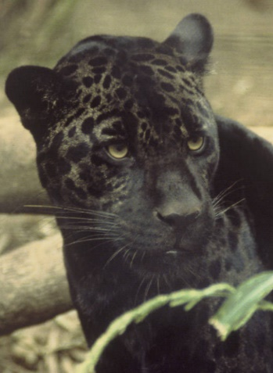
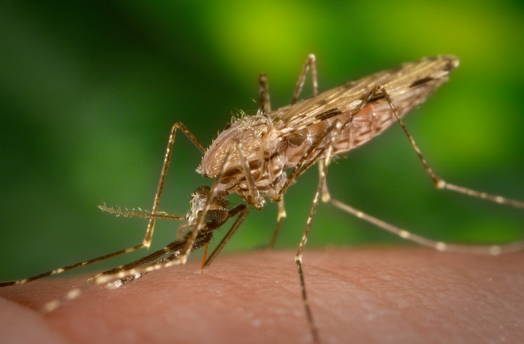
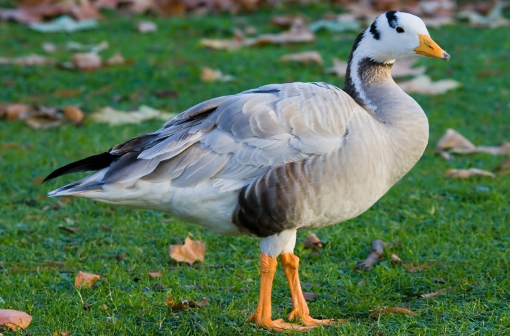
Case Studies
SE L1-3
1 | 2 | 3
Notes:
Distribute Variation in Organisms Handout
Allow quiet time for participants to read their case study. Remind them that they should take notes on anything that will help them answer the focus question.
Have participants move into expert groups. For the number of teachers we have, we will probably have two groups for each of the three case studies. Have the participants discuss what they read and what their ideas are about their case. As participants discuss their ideas, use STeLLA Strategy 2, Ask questions to probe student ideas and predictions, to learn more about student prior knowledge and misconceptions. Ask them to make any notes or revise their ideas to the focus question as they talk.

Slide 5
Comparing Ideas
SE L1-4
Share the story of your case with your home group.
Describe the variation and your expert group’s ideas about how the variation occurred.
Discuss the similarities and differences between your ideas about the causes of variation.
Similarities between our ideas about the focus question | Differences between our ideas about the focus question
Notes:
Participants should return to their home groups. Remind them that in a jigsaw they really get a chance to learn about all cases and that we will revisit them over the course of the lessons. Have participants share their case study and the experts group’s ideas about how the variation in organisms happens. Remind participants to take notes about the other case studies and ideas.
Ask them to discuss the similarities and differences between their ideas about the focus question. Have them create a two-column table like the one shown to keep track of their ideas.

Slide 6
Focus Question #1
SE L1-5
What might cause individuals to have versions of a trait that are different from others in the same species?
Notes:
Individually, write a paragraph with your best ideas for why some individuals have traits that are different from other individuals of the same species. Include a drawing to support your explanation.

Slide 7
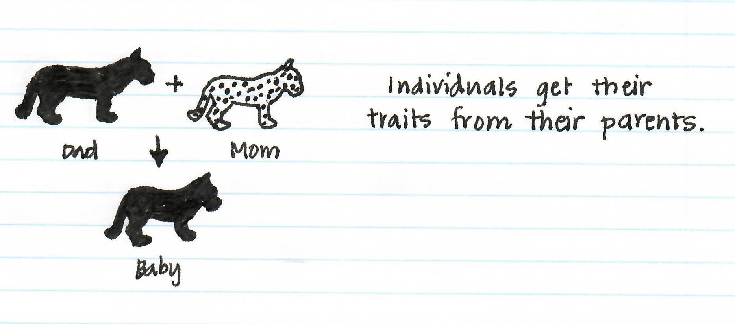
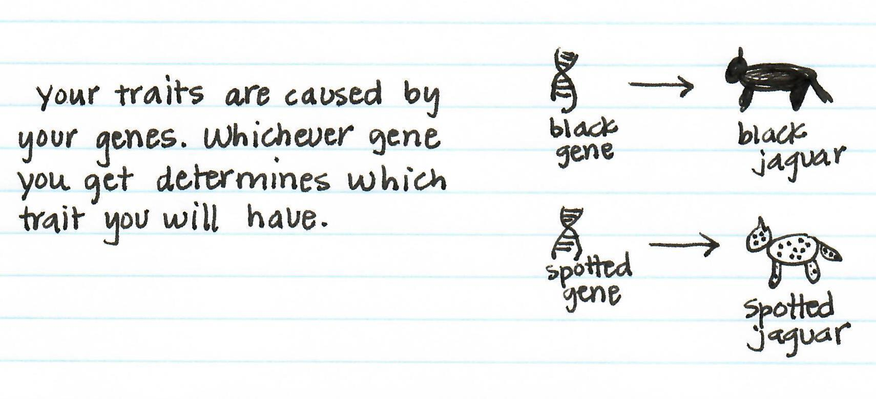
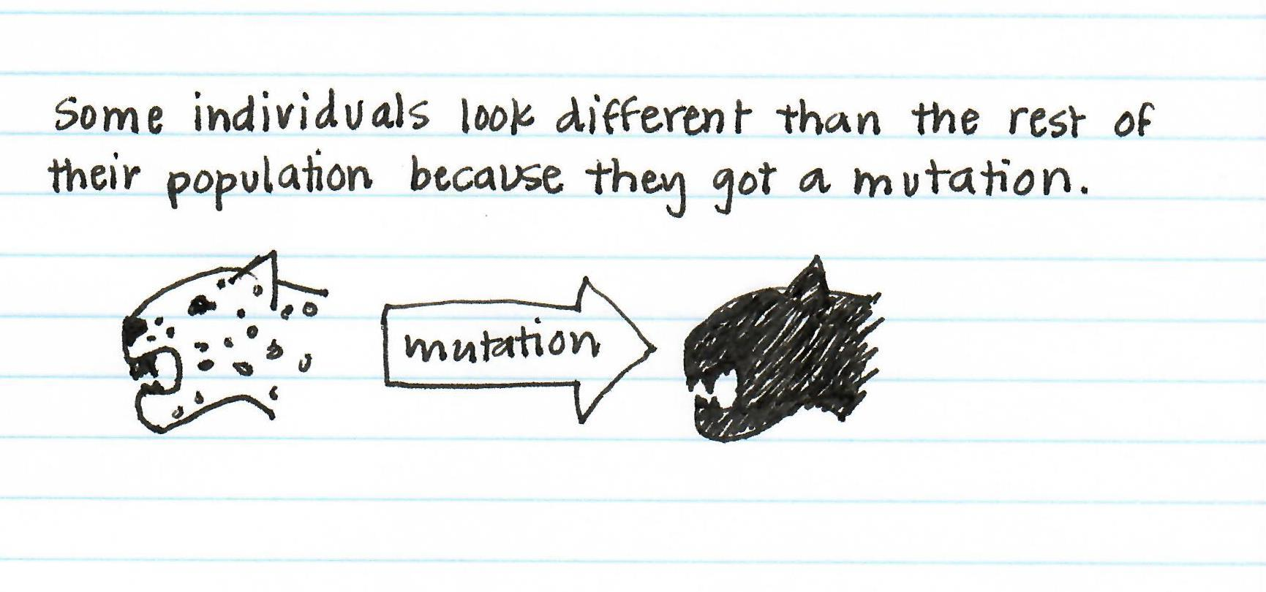
Possible Explanations for Variation
SE L1-5
Notes:
Distribute Explanations for Variation Handout
Have participants read the Explanations for Variations handout to see some ideas that might describe how organisms are so varied. Ask participants to think about which explanation is most similar to their ideas.

Slide 8
Your Ideas About Variations
SE L1-5
Parents | Genes
Mutation | None or do not know
Notes:
Have participants number each of the sentences in the paragraph they wrote and draw a table like the one shown here. Then have them write the number of each sentence in one of the boxes.
Summarize
Ask them, based on how many numbers are in each box, which idea they seem to agree with most. If they have a lot of numbers in the none/do not know box, they should explain why their ideas are different. Have them discuss with their group. Share out some key ideas. Ask elicit and probe questions to uncover student thinking.
Link to Next Lesson
Remind participants that today they examined possible explanations for the variations that exist between individuals of the same species.
Share that in the next lesson, they will explore the source of the variations they observed in this lesson.

