Slide 1
A Study of Traits
Lesson 3

Slide 2
Focus Question #3
SE L3-1
How can a protein determine the traits, and versions of a trait, of an individual organism?
Notes:
BSCS focus: Models and CSW
Link to the previous lesson
Ask a participant to summarize what they learned in the previous lesson. Then ask others whether they agree and if there are other ideas they would like to add.
Participants should be able to describe that there are many different types of proteins in the body. They should also be able to say that some changes in organisms are caused by different amounts of proteins while others are caused by a changed structure of those proteins. Those changes can affect the way a protein functions.
Ask a participant to read the focus question. Ask if they can think of another example that might be interesting. Allow time write their ideas about the question. Reassure them that they are just beginning the lesson so they may not know the answer, but to write their best ideas (modeling for how they should remind students). They will have a chance to revise their ideas as they work through the rest of the lesson.
Allow some time for teams to discuss their thoughts. Ask elicit and probe questions to the groups. Encourage them to consider which ideas are similar and which ideas are different between their ideas.

Slide 3
Puzzle Pieces
SE L3-2
Notes:
As participants work through this lesson, they are going to learn more about what makes up proteins. Tell them that to start thinking about that, they are going to have a chance to think about how smaller pieces can be put together to make a larger object.
Distribute the puzzle pieces (set 1). Ask teams to come up with as many ways as they can to put the pieces together. Give them a time limit, such as two minutes. Because the puzzle pieces are all the same, they should be able to put them together in many different sequences, but the overall shape should look the same. Have participants share out both the sequence they used and the shape they formed for each sequence.
Give participants some time to think individually and write their answers. Encourage them to draw their ideas if it is easier for them to think about the question that way. participants should begin to realize that they may not be able to make as many sequences if the pieces are different. The shapes of the resulting combinations may also be different. Remind participants that they are beginning to think about proteins, imagining the puzzle pieces to be like the building blocks of a protein.
Distribute puzzle piece set 2 to teams of participants. Give them a few minutes to try putting the pieces together in different orders and to draw at least three combinations.
Ask an elicit question, based on what you know about proteins at this point, do you think the building blocks of proteins are more likely to be like the puzzle pieces in step 3 or in step 4?
Allow time for participants to work individually to answer the questions
What happens when the puzzle pieces are different from one another?
How does that match with the prediction you made in Step 4?
Lead a class discussion of the work that participants have been doing. Encourage them to use the Communicating in Scientific Ways sentence stems as they add to the discussion (STeLLA Strategy 8). Give participants some time to look at the chart and then share a few examples. Be sure to asking probe questions to make sure that participants are making their thinking about the question clear.
Once participants have had an opportunity to discuss what happens when the puzzle pieces are different from one another and how that matched their predictions, ask the elicit question, Remember that we are thinking about proteins and how there can be so many different proteins. Does anyone have any new ideas based on the work they have done?
The key here is to probe participants’ thinking. The activity has not given them specific information about proteins, but if they have learned about proteins that need a specific shape to function, such as an enzyme, they may be developing some initial ideas about how using different building blocks might help proteins have a specific shape. participants do not need to understand this idea at this point in the lesson, but having a clear understanding of where participants are in their thinking will help you know where to focus in the remainder of the lesson.

Slide 4
Puzzle Pieces
SE L3-3
Notes:
As participants work through this lesson, they are going to learn more about what makes up proteins. Tell them that to start thinking about that, they are going to have a chance to think about how smaller pieces can be put together to make a larger object.
Distribute the puzzle pieces (set 1). Ask teams to come up with as many ways as they can to put the pieces together. Give them a time limit, such as two minutes. Because the puzzle pieces are all the same, they should be able to put them together in many different sequences, but the overall shape should look the same. Have participants share out both the sequence they used and the shape they formed for each sequence.
Give participants some time to think individually and write their answers. Encourage them to draw their ideas if it is easier for them to think about the question that way. participants should begin to realize that they may not be able to make as many sequences if the pieces are different. The shapes of the resulting combinations may also be different. Remind participants that they are beginning to think about proteins, imagining the puzzle pieces to be like the building blocks of a protein.
Distribute puzzle piece set 2 to teams of participants. Give them a few minutes to try putting the pieces together in different orders and to draw at least three combinations.
Ask an elicit question, based on what you know about proteins at this point, do you think the building blocks of proteins are more likely to be like the puzzle pieces in step 3 or in step 4?
Allow time for participants to work individually to answer the questions
What happens when the puzzle pieces are different from one another?
How does that match with the prediction you made in Step 4?
Lead a class discussion of the work that participants have been doing. Encourage them to use the Communicating in Scientific Ways sentence stems as they add to the discussion (STeLLA Strategy 8). Give participants some time to look at the chart and then share a few examples. Be sure to asking probe questions to make sure that participants are making their thinking about the question clear.
Once participants have had an opportunity to discuss what happens when the puzzle pieces are different from one another and how that matched their predictions, ask the elicit question, Remember that we are thinking about proteins and how there can be so many different proteins. Does anyone have any new ideas based on the work they have done?
The key here is to probe participants’ thinking. The activity has not given them specific information about proteins, but if they have learned about proteins that need a specific shape to function, such as an enzyme, they may be developing some initial ideas about how using different building blocks might help proteins have a specific shape. participants do not need to understand this idea at this point in the lesson, but having a clear understanding of where participants are in their thinking will help you know where to focus in the remainder of the lesson.

Slide 5
Amino Acids
SE L3-4
Notes:
Have participants study the amino acids individually. Then draw a two-column chart on the board with the headings “similarities among the 20 amino acids” and “differences among the 20 amino acids.” Have participants draw the table and begin filling it in individually. Then have them discuss their ideas with their teams.
Have them begin to share the similarities and differences in the whole group. Ask people to point to the specific structures they are referring to (preferably on a document camera). When they begin to notice some of the key features, move to the next slide to show them the general structure of amino acids.

Slide 6
Amino Acids

Slide 7
General Structure of an Amino Acid
Variable side chain (residue)
R
H
N
C
C
OH
H
H
O
amino group
carboxylic acid group
Notes:
Some of the key similarities that participants should notice are that there is a blue (nitrogen) atom attached to the end of each amino acid. There are also two red (oxygens) atoms attached to the same end, as well as one black atom (hydrogen). The key difference is between the amino acids is that the other atoms that are connected to the carbon are different for each amino acid. This side chain is also known as the “residue,” which is why it is labeled as “R.” The side chain can have many atoms or just a few. Once students have recognized these features, introduce the general structure of an amino acid. You may wish to share with them that the name “amino acid” is derived from the amino group and the carboxylic acid group.
Blue – amino group
Red – carboxylic acid group
Green – variable side chain, “residue”
Distribute red and blue markers or colored pencils. Show participants how this form of representing the amino acid aligns with the images they were studying. Then ask them to draw blue arrows to the amino and red carboxylic acid groups and circle the R groups on a few amino acids to see that they do all take this form.

Slide 8
Amino Acid Bonding
SE L3-5
+
+

Slide 9
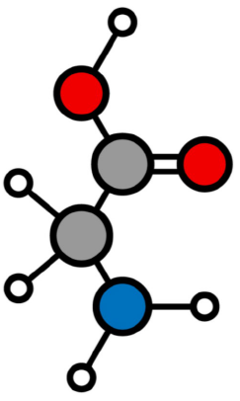
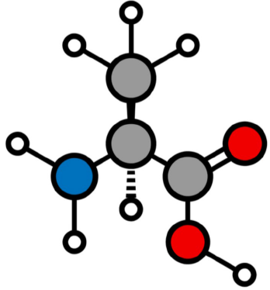
Puzzle Pieces
SE L3-6
For each amino acid, identify the
Amino group
Carboxylic acid group
R group
Use the rule you developed to put together the five amino acids in your puzzle set.
Compare your peptide with two other teams.
Notes:
As participants work through this lesson, they are going to learn more about what makes up proteins. Tell them that to start thinking about that, they are going to have a chance to think about how smaller pieces can be put together to make a larger object.
Distribute the puzzle pieces (set 1). Ask teams to come up with as many ways as they can to put the pieces together. Give them a time limit, such as two minutes. Because the puzzle pieces are all the same, they should be able to put them together in many different sequences, but the overall shape should look the same. Have participants share out both the sequence they used and the shape they formed for each sequence.
Give participants some time to think individually and write their answers. Encourage them to draw their ideas if it is easier for them to think about the question that way. participants should begin to realize that they may not be able to make as many sequences if the pieces are different. The shapes of the resulting combinations may also be different. Remind participants that they are beginning to think about proteins, imagining the puzzle pieces to be like the building blocks of a protein.
Distribute puzzle piece set 2 to teams of participants. Give them a few minutes to try putting the pieces together in different orders and to draw at least three combinations.
Ask an elicit question, based on what you know about proteins at this point, do you think the building blocks of proteins are more likely to be like the puzzle pieces in step 3 or in step 4?
Allow time for participants to work individually to answer the questions
What happens when the puzzle pieces are different from one another?
How does that match with the prediction you made in Step 4?
Lead a class discussion of the work that participants have been doing. Encourage them to use the Communicating in Scientific Ways sentence stems as they add to the discussion (STeLLA Strategy 8). Give participants some time to look at the chart and then share a few examples. Be sure to asking probe questions to make sure that participants are making their thinking about the question clear.
Once participants have had an opportunity to discuss what happens when the puzzle pieces are different from one another and how that matched their predictions, ask the elicit question, Remember that we are thinking about proteins and how there can be so many different proteins. Does anyone have any new ideas based on the work they have done?
The key here is to probe participants’ thinking. The activity has not given them specific information about proteins, but if they have learned about proteins that need a specific shape to function, such as an enzyme, they may be developing some initial ideas about how using different building blocks might help proteins have a specific shape. participants do not need to understand this idea at this point in the lesson, but having a clear understanding of where participants are in their thinking will help you know where to focus in the remainder of the lesson.

Slide 10
Protein Facts
SE L3-7
Many amino acids are bonded together to make a protein. Three facts about proteins that will help you understand them better are:
Different proteins have different sequences of amino acids.
Different sequences of amino acids result in proteins that have different structures.
Within a species, a particular protein, such as MC1R or hemoglobin, will have the same or nearly the same sequence in each individual.
Notes:
Have teams discuss the three statements to make sure they know what each means.
Then distribute the MC1R Handout with the amino acid sequences on one side and the reading and protein structure on the other.
Have participants study the side with the amino acid sequences and determine what is different between them. Emphasize that this is just a small portion of the sequence.
They should notice that there are fewer amino acids in the black jaguar protein piece than in the spotted jaguar piece.
They should also see that the first nine amino acids are the same.
Some may also realize that there is an alanine-glycine at the end of each sequence, but do not point this out if they do not notice.
The teams should then read the information in the paragraphs and make sense of the figure. Tell them that they are going to have a chance to draw the mechanism for how different colored jaguars happen, so they should underline anything that will help them draw a picture.

Slide 11
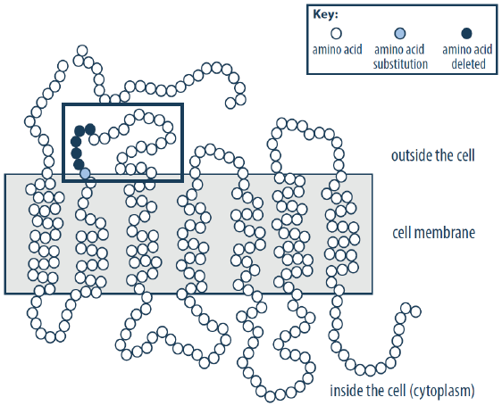
MC1R Protein
SE L3-8

Slide 12
Summarize Your Understanding
SE L3-9
Draw a picture to show the mechanism that causes a jaguar to be spotted.
Draw a second picture to show the mechanism that causes a jaguar to be black.
Label your diagrams so it is clear what each part of your picture represents. In the diagrams, show the
hormone protein
MC1R protein
types of melanin (pheomelanin or eumelanin)

Slide 13
Synthesize and Summarize
SE L3-10
Characteristic of a Protein | Is the characteristic the same or different between MC1R, hormone and melanin?
The twenty amino acids that can be used as the building blocks to make a peptide or protein.
The process by which the amino acids bond to each other.
The sequence of amino acids.
The structure of the proteins.

Slide 14
Question Board

Slide 15
Focus Question #3
SE L3-10
How can a protein determine the traits, and versions of a trait, of an individual organism?
Notes:
BSCS focus: Models and CSW
Link to the previous lesson
Ask a participant to summarize what they learned in the previous lesson. Then ask others whether they agree and if there are other ideas they would like to add.
Participants should be able to describe that there are many different types of proteins in the body. They should also be able to say that some changes in organisms are caused by different amounts of proteins while others are caused by a changed structure of those proteins. Those changes can affect the way a protein functions.
Ask a participant to read the focus question. Ask if they can think of another example that might be interesting. Allow time write their ideas about the question. Reassure them that they are just beginning the lesson so they may not know the answer, but to write their best ideas (modeling for how they should remind students). They will have a chance to revise their ideas as they work through the rest of the lesson.
Allow some time for teams to discuss their thoughts. Ask elicit and probe questions to the groups. Encourage them to consider which ideas are similar and which ideas are different between their ideas.

