Slide 1

A Study of Traits
Lesson 5

Slide 2


Focus Question #5
SE L5-1
How does the information in a DNA sequence found in the nucleus get to the cytoplasm where proteins are made?
Notes:
BSCS focus: Models and CSW
Link to the previous lesson
Ask a participant to summarize what they learned in the previous lesson. Then ask others whether they agree and if there are other ideas they would like to add.
Participants should be able to describe that there are many different types of proteins in the body. They should also be able to say that some changes in organisms are caused by different amounts of proteins while others are caused by a changed structure of those proteins. Those changes can affect the way a protein functions.
Ask a participant to read the focus question. Ask if they can think of another example that might be interesting. Allow time write their ideas about the question. Reassure them that they are just beginning the lesson so they may not know the answer, but to write their best ideas (modeling for how they should remind students). They will have a chance to revise their ideas as they work through the rest of the lesson.
Allow some time for teams to discuss their thoughts. Ask elicit and probe questions to the groups. Encourage them to consider which ideas are similar and which ideas are different between their ideas.

Slide 3
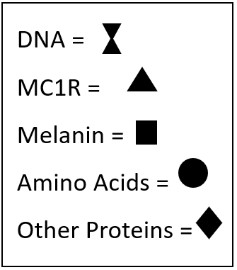
Getting Information from One Part of a Cell to Another
SE L5-2
Nucleus
Cytoplasm

Slide 4
Questions
DNA is in the nucleus while amino acids and proteins are in the cytoplasm. How do the DNA instructions get from the nucleus to the cytoplasm?
There are fewer DNA molecules than proteins. How can so many proteins be made from a single set of directions?

Slide 5
MC1R
SE L5-3
GTG CTG GAG ACG GCC GTC ATG CTG CTG CTG GAG
What do you notice about the sequence?
Use the key to write the sequence for a strand that is complimentary to the one given
  Key:
  For every G, write a C
  For every C, write a G
  For every A, write a U
  For every T, write an A

Slide 6
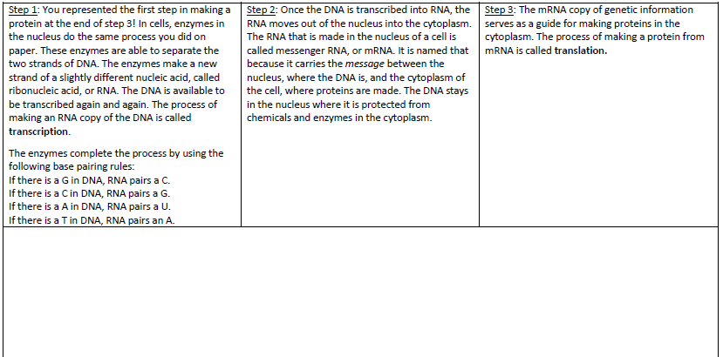
Making a Protein: What Happens in the Nucleus
SE L5-4
Draw a cell that fills the lower half of the page.
Then complete the Etch-a-Sketch for the reading.

Slide 7
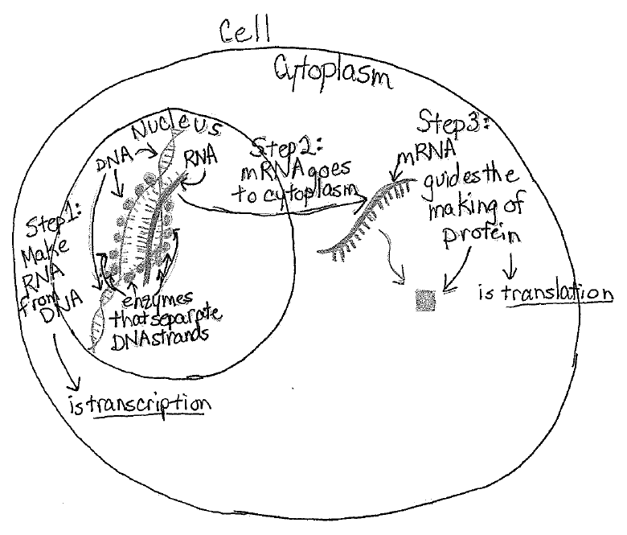
Etch-A-Sketch Student Artifact

Slide 8
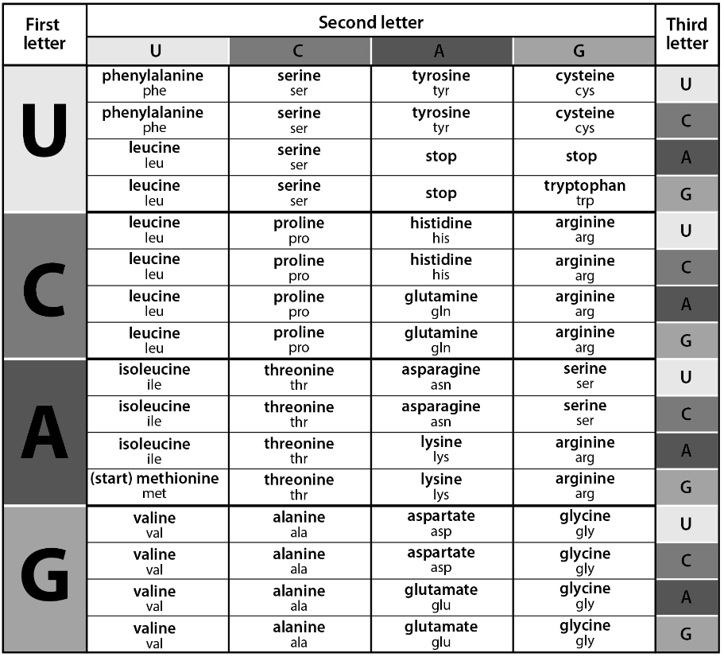
Translating the Message in mRNA
SE L5-5

Slide 9
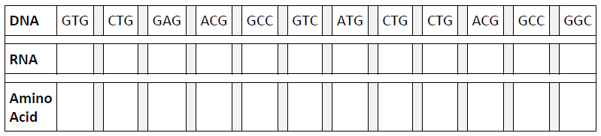
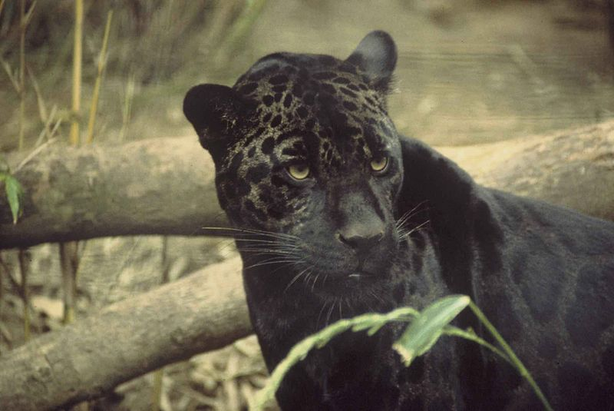
Translating the Message in mRNA
SE L5-6

Slide 10
DNA Mutations
SE L5-7
Annotate the article using the following symbols:
  Underline information that helps explain how the DNA sequence changed
  Star information that helps predict what the offspring of a black jaguar might look like
  Put a question mark ? next to any sentence you do not understand

Slide 11
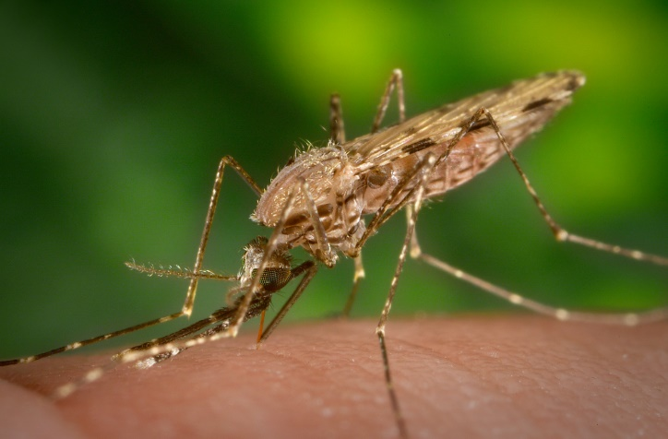
Mosquito Mutation
SE L5-8

Slide 12
Focus Question #5
SE L5-9
How does the information in a DNA sequence found in the nucleus get to the cytoplasm where proteins are made?
Notes:
BSCS focus: Models and CSW
Link to the previous lesson
Ask a participant to summarize what they learned in the previous lesson. Then ask others whether they agree and if there are other ideas they would like to add.
Participants should be able to describe that there are many different types of proteins in the body. They should also be able to say that some changes in organisms are caused by different amounts of proteins while others are caused by a changed structure of those proteins. Those changes can affect the way a protein functions.
Ask a participant to read the focus question. Ask if they can think of another example that might be interesting. Allow time write their ideas about the question. Reassure them that they are just beginning the lesson so they may not know the answer, but to write their best ideas (modeling for how they should remind students). They will have a chance to revise their ideas as they work through the rest of the lesson.
Allow some time for teams to discuss their thoughts. Ask elicit and probe questions to the groups. Encourage them to consider which ideas are similar and which ideas are different between their ideas.

Slide 13
Synthesize and Summarize
SE L5-9
What is the best explanation for the similarities and differences we see in individuals within a species – not only for one species, but for every species of plant and animal?
Lesson | Evidence | Parents | Genes | Mutation
1
2
3
Notes:
Introduce Central Question: Why do individuals of the same species all look different? What causes the variations we see in individuals?
Introduce the central question for the unit and ask participants to respond to the question in their workbooks, leaving space so that they can modify their response as needed.
Ask participants to share their ideas with the entire group. Use STeLLA Strategy 1: Ask questions to elicit student ideas and predictions to get a variety of ideas out. Probe ideas when needed.

