Slide 1

A Study of Traits
Lesson 7

Slide 2

Question Board

Slide 3

Focus Question #7
SE L7-1
If individuals have the same version of one trait, will they also have the same version of other traits?

Slide 4
Chromosomes and Alleles:
From Parents to Offspring
SE L7-2
How does all the DNA that a cell contains fit into the nucleus?
Use a physical model to test your ideas.
How do chromosomes influence the traits that a jaguar, human, or other organism inherits?

Slide 5
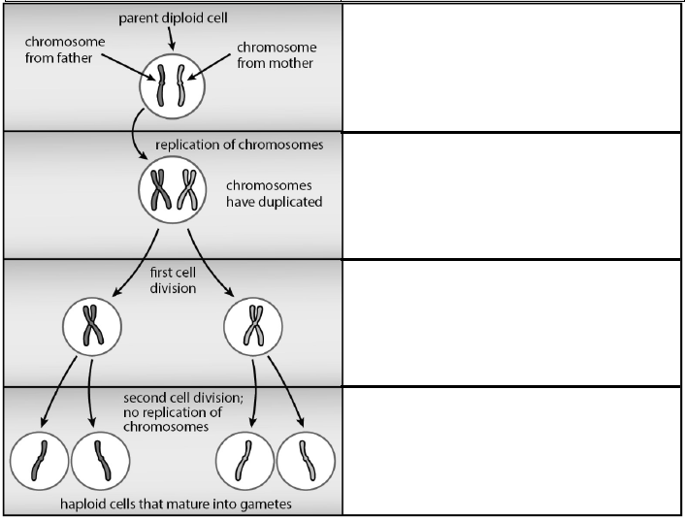
The Process of Meiosis
SE L7-4

Slide 6
Modeling Meiosis
SE L7-6
1 pair of chromosomes
2 pairs of chromosomes
23 pairs of chromosomes?
  2²³ = 8,388,608 possible combinations!

Slide 7
Analyzing the Model
How did the model help us
  make predictions?
  understand meiosis?
  explain the relationship between different traits?
What are the strengths and limitations of the overview chart and of the craft stick models?

Slide 8
Focus Question #7
SE L7-4
If individuals have the same version of one trait, will they also have the same version of other traits?

Slide 9
Synthesize and Summarize
SE L7-7
What is the best explanation for the similarities and differences we see in individuals within a species – not only for one species, but for every species of plant and animal?
Lesson | Evidence | Parents | Genes | Mutation
6
7
Notes:
Introduce Central Question: Why do individuals of the same species all look different? What causes the variations we see in individuals?
Introduce the central question for the unit and ask participants to respond to the question in their workbooks, leaving space so that they can modify their response as needed.
Ask participants to share their ideas with the entire group. Use STeLLA Strategy 1: Ask questions to elicit student ideas and predictions to get a variety of ideas out. Probe ideas when needed.

